Slide 1
CEGE0096: Geospatial Programming
Lecture 6: Geospatial Modelling
Dr. Aldo Lipani

Slide 2
Geospatial Modelling

Slide 3
Definition of GIS
“A Geographic Information System is a computer-based information system that enables capture, modelling, storage, retrieval, sharing, manipulation, analysis and presentation of geographically referenced data.”
Worboys and Duckham, 2004
In order to store, share, manipulate, analyse and present, we first need to capture and model.
Capturing and modelling is dependent on our view of reality.

Slide 4
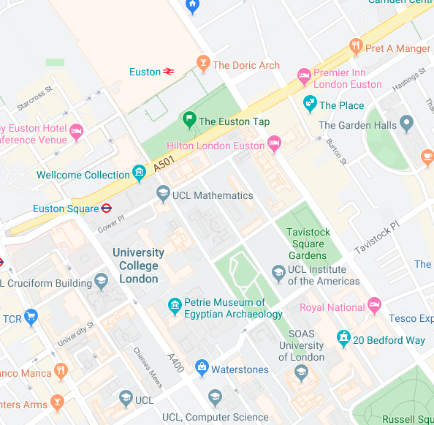
How do we Represent Reality?
On a piece of paper, draw three separate maps of:
Gower Street and its potholes;
The path to get from Euston Station to Chadwick Building;
Gower Street in a map of the UK.

Slide 5
How do we Represent Reality?
Each map demands a different way of representing Gower Street.
Each representation has advantages and disadvantages.
The representation is a simplification of the real-world feature.
Choosing the correct representation is an important decision.

Slide 6
Real vs. Digitally Represented Worlds
The real world:
Digitally represented world:
No straight lines
No hard edges
3D + Time
Ambiguous
Missing information
Unusual, unexpected features
Locations can be a function of probability
Simplified geometry
2D (paper)
2D + Time (screen)
3D + Time (VR)
Specified time
Locations may not be precise
Locations may not be accurate

Slide 7
Accuracy vs. Precision
Accuracy is the closeness of a measured value to a standard or known value.
Ex 1. If you measure 3.2 meters but the actual or known distance is 10 meters:
Your measurement is not accurate.
It is not close to the known value.
Precision is the closeness of two or more measurements to each other.
Precision is independent of accuracy.
Ex 2. If you measure a distance five times, and each time you measure 3.2 meters, then your measurement is precise. Even if the distance is actually 10 meters.

Slide 8
Accuracy vs. Precision (II)

Slide 9
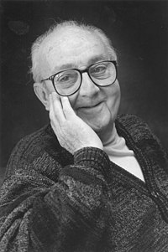
Modelling
“A model is an artificial construction in which parts of one domain, termed the source domain, are represented in another domain, termed the target domain.”
Worboys and Duckham, 2004
A model is a simplification and an abstraction away from the source domain.
“All models are wrong, but some are useful.”
George E. P. Box
Examples include paper and online maps, flight simulators, health models like hospital planning, meteorological models like weather forecasting, and geological models.

Slide 10
Fidelity vs Implementability
The usefulness of a model is a trade-off between fidelity and implementability.
Fidelity is the degree to which the model represents the world;
Implementability is the degree to which the model can be used for storage, analysis, etc.

Slide 11
The Modelling Process – Waterfall Model
Application Domain
1
Application Domain Model
2
initial
study
Conceptual
Model
Computational Models
3
system
analysis
Logical Model
4
system
design
Physical
Model
system
implementation
5

Slide 12
Application Domain
1
The real world is referred to as the Application domain.
Observe the real world.
Everything happens in the context of the real world.

Slide 13
Application Domain Model
2
Focus only on the parts of the real world that are important to your world.
It is important to identify what is important and what is not.
At this stage, you would produce a document with descriptive notes, diagrams, tables, etc.

Slide 14
Conceptual Model
3
What will the system do?
Identify phenomena, their attributes and their relationships to the world.
The real-world phenomena can be conceptualised as either:
Continuous fields
Discrete features

Slide 15
Continuous Fields
A continuous field has a characteristic that is spatially continuous.
Values do not suddenly change at boundaries:
Temperature
NO₂ concentration

Slide 16
Discrete Features
A discrete feature (aka entity or object) is distinct from its environment and its neighbours due to an identifiable characteristic:
Building
Tree
Country
A postcode
Discrete features can be classified.
Discrete features can be aggregated.

Slide 17
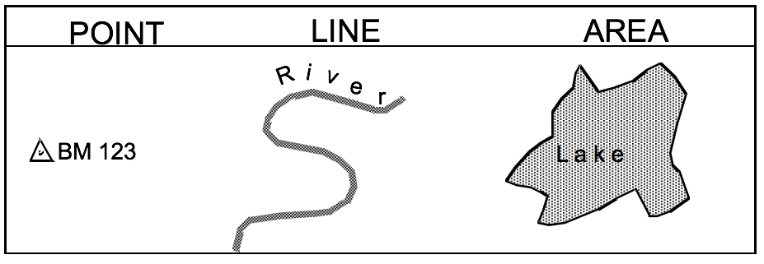
Dimensionality
Features can be conceptually modelled as:
0D entities, i.e., Points;
1D entities, i.e., Lines;
2D entities, i.e., Areas, Surfaces;
3D entities, i.e., Volumes, Solids.
Modelled either in 2D or 3D, e.g., a point in 3D space or a point on a 2D surface.
Features can be modelled in time.

Slide 18
Logical Model
4
How will the system implement the conceptual computational model?
Identify how phenomena might be represented in an information system.
What datatypes would be best to represent attributes?
E.g., how to represent colours?
“red” -- string
integer
#FF0000 -- hexadecimal integer representing RGB
(1.0, 0, 0) – floating point RGB tuple

Slide 19
Spatial Representations
Identify how the geometry of features and fields can be represented in the information system:
Vector representation;
Raster representation.

Slide 20
Vector Representation
A vector is a line segment (edge, wire) defined by its endpoints (vertices).
Line segments may be curved.
Requires less storage than raster for the same fidelity.
A 0D geometric entity
A 1D geometric entity.
A 2D geometric entity.

Slide 21
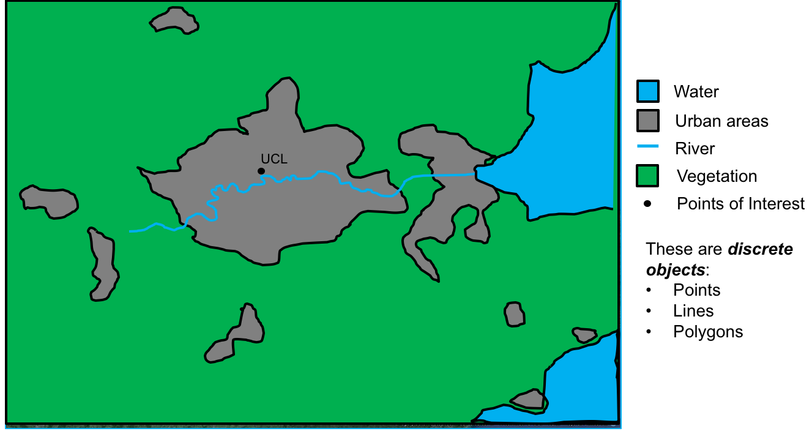
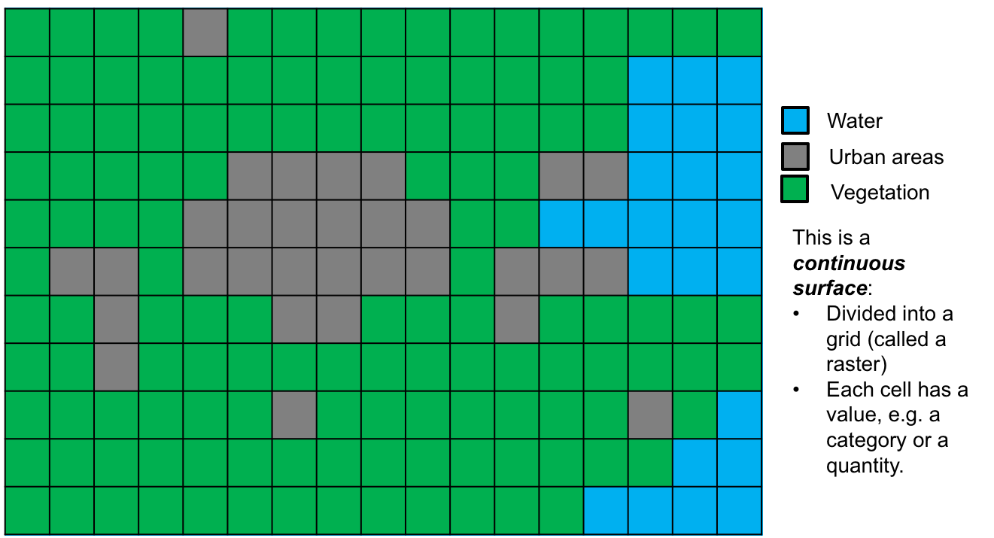
Raster Representation
Structured as an array or grid of cells, referred to as pixels (or grid cells).
The 3D equivalent is a 3D array of cubic cells called voxels.
Each raster cell is addressed by its position in the array.
Each cell can store a number as an attribute.
Attributes can be binary, integer, or floating point.

Slide 22
Raster Representation (II)
Each cell in a raster will have a fixed dimension (the resolution).
The higher the resolution, the more detail can be represented in the raster at the expense of memory.
Rasters can be made on the fly using a mathematical function.
E.g., inverse distance squared values from a point feature.

Slide 23
Questions
How would you implement the Vector representation in Python?
How would you implement the Raster representation in Python?

Slide 24
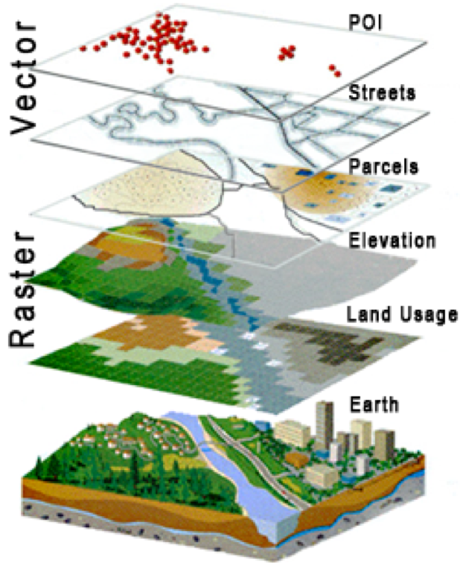
Layers (aka Levels)
Geospatial fields and features representing identical phenomena are collated together in layers.
In computer-aided design, levels are used primarily for visualisation.
Levels are less disciplined as different object types may exist together on the same level.
Layers can be combined with other layers for analysis and visualisation.
A fully-capable GIS can combine data from different layers.

Slide 25
Physical Model
5
Transcribe the logical model into a data file.
Load the data file into a program.
The implemented physical model can be simulated, analysed and visualised.

Slide 26
Exercise (Reflection on the Assignment)
Identify the modelling steps we took in the 1st Assignment to get from the Application Domain (the problem) to the Physical Model (the solution).
Application Domain
1
Application Domain Model
2
initial
study
Conceptual
Model
Computational Models
3
system
analysis
Logical Model
4
system
design
Physical
Model
system
implementation
5

Slide 27
The Modelling Process – Agile
Definition:
Agile is an iterative and incremental approach to software development.
It emphasises flexibility, customer satisfaction, and rapid delivery.
Core Focus:
Customer satisfaction through early and continuous delivery of valuable software.
Welcoming changing requirements, even late in development.
Methodology Characteristics:
Collaborative team environment that promotes regular cadence of work and face-to-face communication.
Working software is the primary measure of progress.
Cultural Shift:
Agile requires a shift in organisational culture, focusing on collaboration, customer feedback, and small, rapid releases.

Slide 28
Key Principles of Agile
Agile Manifesto Principles:
The highest priority is to satisfy the customer through early and continuous delivery of valuable software
Welcome changing requirements, even late in development
Delivering Value:
Deliver working software frequently, with a preference for shorter timescales
Sustainable Development:
Sustainable development is maintained indefinitely. Agile processes promote a consistent pace
Continuous attention to technical excellence and good design enhances agility.
Team Dynamics:
Simplicity—the art of maximising the amount of work not done—is essential
The best architectures, requirements, and designs emerge from self-organising teams
Reflect & Adjust:
At regular intervals, the team reflects on how to become more effective, then tunes and adjusts its behaviour accordingly.

Slide 29
Agile vs Waterfall: A Comparison
Approach to Development:
Waterfall: Sequential and linear, each phase completed before the next begins
Agile: Iterative and incremental, with overlapping development phases
Flexibility and Changes:
Waterfall: Changes are difficult and costly once the project is underway
Agile: Welcomes and adapts to changes even in late stages of development
Project Management:
Waterfall: Emphasizes upfront planning and schedule predictability
Agile: Focuses on adaptability and customer feedback throughout the project

Slide 30
Agile vs Waterfall: A Comparison (II)
Team Collaboration:
Waterfall: Roles are more siloed and specialised
Agile: Encourages cross-functional teams and collaboration
Feedback Incorporation:
Waterfall: Feedback is generally gathered after the completion of the project
Agile: Continuous feedback is sought and incorporated throughout the project
Testing and Quality:
Waterfall: Testing is a distinct final phase
Agile: Testing is integrated throughout the development process
Outcome Predictability:
Waterfall: More predictable outcomes at the cost of less flexibility
Agile: Flexible outcomes adaptable to changing requirements

Slide 31
Understanding the Scrum Framework
Scrum Roles:
Product Owner: Responsible for defining the features of the product and prioritising the work
Scrum Master: Facilitates the Scrum process, helps resolve obstacles, and ensures close cooperation across roles
Development Team: Cross-functional group responsible for delivering the product.
Scrum Events:
Sprint Planning: the team decides what work will be accomplished during the sprint
Daily Stand-Up: a daily meeting to sync up on progress and impediments
Sprint Review: at the end of each sprint to present the work done and gather feedback
Sprint Retrospective: at the end of each sprint where the team reflects on the process and identifies improvements

Slide 32
Other Modelling Methods

Slide 33
Python Packages

Slide 35
NumPy
NumPy is an independent scientific computing package for Python.
Written in C for speed and efficiency. NumPy arrays (lists) occupy less memory and are faster than Python lists!
import numpy as np
The fundamental data structure of NumPy is the array:
arr = np.array([1, 2, 3, 4])

Slide 36
NumPy Arrays
Arrays can be 1D, 2D, 3D, or n-dimensional:
arr = np.array([[1, 2, 3, 4], [4, 3, 2, 1]])
Arrays can be created from any datatype. This is specified using the dtype keyword.
arr = np.array([1, 2, 3, 4], dtype=int)
You can also use C types:
arr = np.array([1, 2, 3, 4], dtype=np.int32)

Slide 37
Addressing Cells
The individual cells of an array can be addressed using [,].
For a 2D array we can address the the first element of the second row as:
arr = np.array([[1, 2, 3, 4], [4, 1, 2, 3]])
arr[1,0]

Slide 38
Stacking Arrays
Two arrays can be stacked together both vertically and horizontally.
Column-wise:
np.hstack([arr1, arr2])
Row wise:
np.vstack([arr1, arr2])

Slide 39
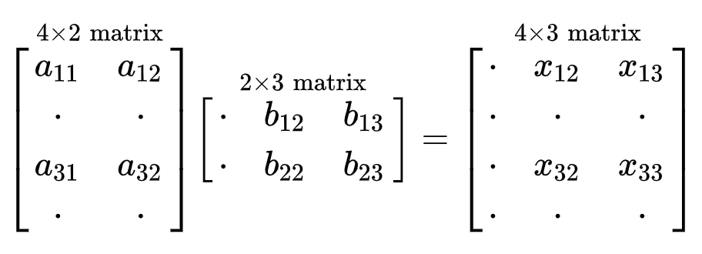
Arrays Operations
NumPy offers a new set of operations you can perform on arrays.
You can sum two arrays (+,-), compute the power exponentiation (**), conditions (==, <, >, <=, =<), and element-wise multiplication (*,/).
You can also perform matrix multiplications (@):

Slide 40
Documentation
http://numpy.org

Slide 41
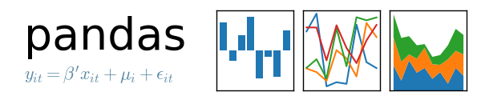

Slide 42
Pandas
Pandas is a software library written for the Python for data manipulation and analysis.
import pandas as pd
It offers data structures and operations for manipulating numerical tables and time series.
These are called Series and DataFrames.
A Series is a column, and a DataFrame is a multi-dimensional table made up of a collection of Series.

Slide 43
Creating a DataFrame from Scratch
A way to create a DataFrame is from a Python dictionary.
data = { 'x': [0, 1, 2, 3], 'y': [3, 2, 1, 0] }
Then, pass it to the pandas DataFrame constructor:
df = pd.DataFrame(data)

Slide 44
Creating a DataFrame from CSVs
With CSV files you can use read_csv:
df = pd.read_csv('points.csv')
To save a data frame as a CSV file:
df.write_csv('points.csv')

Slide 45
Check a DataFrame
To see the first n rows of a DataFrame:
df.head()
To see the last n rows of a DataFrame:
df.tail()
To get info about your DataFrame:
df.info()
To get stats:
df.describe()
To get the dimensions of your DataFrame:
df.shape

Slide 46
Accessing Columns
To know the column names of your DataFrame:
df.columns
To access a column:
df['x']
To access a column and return a DataFrame:
df[['x']]

Slide 47
Accessing Rows
To access the first row of a DataFrame:
df.iloc[0]
To access a single value of the first row:
df.iloc[0]['x']

Slide 48
Documentation
https://pandas.pydata.org/

